Slide 1
Teacher Instructions
Title: Melbourne’s Water Future
Length: Approximately 60 minutes
Description:
Students will work in groups to find and build evidence to show that climate change is affecting, and will continue to affect, Melbourne’s water supply.
Once evidence has been collected from Melbourne’s World of Water – 3D interactive map and supporting resources, students will discuss their findings and share their thoughts.
Time is given to discuss possible solutions and outcomes to this challenge, including follow-up actions and recommendations for individuals and communities/schools.
Overview:
By the end of this lesson, students will:
Know that water is a scarce resource, and it needs to be managed carefully to ensure water security
Understand that Melbourne's water security will be impacted by climate change.
Explain the different methods to overcome water scarcity, by both reducing demand and increasing supply through alternate water sources
Know that Melbourne’s liveability depends on a safe and secure supply of water as well as treating wastewater
Equipment:
This lesson plan utilises digital interactive map, Melbourne’s World of Water, and is best explored by students in groups on laptops.
Alternatively, you could project the map onto a whiteboard (or similar device) to explore together as a class.
***See Notes on each slide for more teaching notes and ideas***

Slide 2
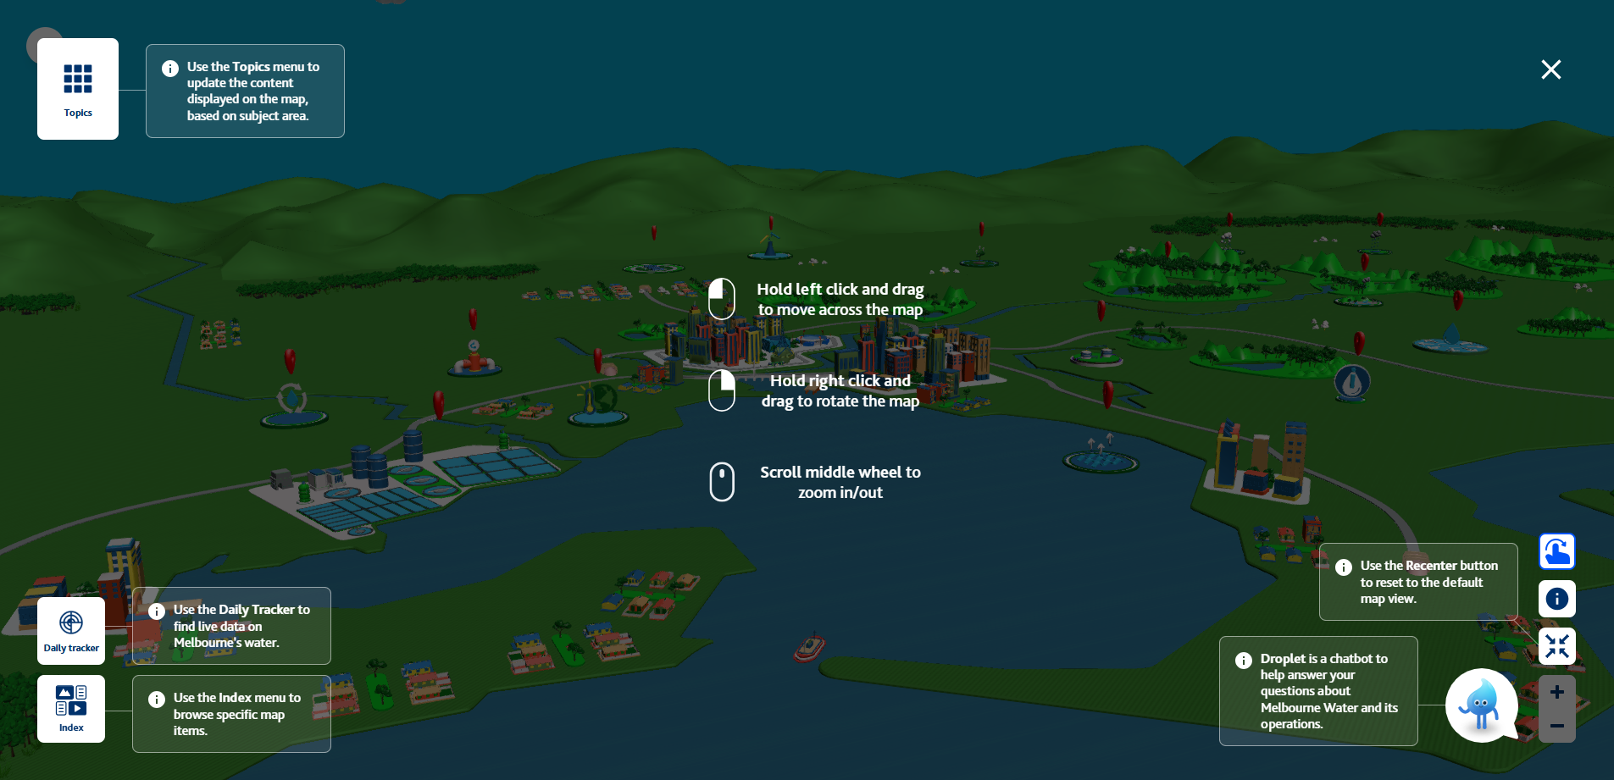
Teacher Instructions (cont.): Interactive map
The interactive map, Melbourne’s World of Water ,is a tool that can be used for guided or independent learning. You will find links throughout this document that will take you to the specific locations, however students are able to discover the answers to the guiding questions through exploring the map – if time permits.
Introduce students to the digital interactive map:
• Basic controls and navigation.
• Map topics and content index.
Additional instructions on the features of the map can be found via this direct link

Slide 3
Instructions
The following is a suggested sequence of activities and time allocation. You might want to spend more or less time on specific sections depending on your class and their learning requirements. All resources can be edited to suit your teaching needs.
Slide | Description | Time
Background information for teachers | Key messages and information about water scarcity and security. Background information on climate change and its effects. | n/a
1.1: Introduction to lesson | Discuss climate change and the potential impact on water | 10 minutes
1.2: Water supply | Explore the water supply in Melbourne using interactive map | 10 minutes
1.3 Temperature & climate explained | Students generate their own graph based on historical temperature data | 15 minutes
1.4: Findings discussion | Discuss student groups findings and trends | 10 minutes
1.5: Actions/Solution | Students share possible solutions for securing our water supply | 10 minutes
1.5: Conclusion | Take away messaging | 5 minutes

Slide 4
Teacher background information
Key messages
Water Supply
Find background information on where Melbourne’s water supply is sourced from: Natural water cycle Urban water cycle
Melbourne’s drinking water is some of the highest quality in the world and comes from rainfall in catchment areas.
It can also be sourced through the Victorian Desalination Plant in times of need (drought).
Climate change
Climate change can affect water supply through:
•Reduced rainfall in the catchment areas.
•Higher temperatures leading to increased evaporation rates in reservoirs
•More extreme weather events (droughts, floods, bush fires)
•Bush fires in catchment areas could contaminate the water source
Solutions
Diversifying our water supply through alternative water sources (desalination, recycled water, storm water harvesting)
Individual actions for water efficiency (shorter showers, creating a raingarden, fixing leaks, etc.)
Notes:
Definitions: Natural water cycle - This is the continuous movement of water through the Earth’s atmosphere, surface and underground. This cycle ensures that water is constantly recycled, supporting life and maintaining environmental balance. The sun powers this process, driving water through the key stages in the video links and on the map.
Urban water cycle – The urban water cycle describes how water is collected, treated, distributed, used, treated again and then returned to the environment.

Slide 5
Melbourne’s Water Future
An investigation into

Slide 6
Learning outcomes
Understand that Melbourne's water security will be impacted by climate change.
Know that water is a scarce resource, and it needs to be managed carefully to ensure water security
Explain the different methods to overcome water scarcity, by both reducing demand and increasing supply through alternate water sources
Know that Melbourne’s liveability depends on a safe and secure supply of water as well as treating wastewater

Slide 7
1.1 Introduction
Task:
Investigate the effects of climate change and how they may impact our water supply.
To do this you will need to find evidence and data from two sources:
Melbourne’s World of Water: www.melbournewater.com.au/world-of-water
The Bureau of Meteorology (BOM): http://www.bom.gov.au/climate/data/index.shtml
Notes:
Extra:
Using the map, students can investigate:
Rainfall data in catchment areas (chapter 2 on a reservoir models)
Reservoir levels over the past 20 years (chapter 3 on reservoir models)

Slide 8
1.2 Introduction to water supply
Notes:
Key messages:
Water is sourced from rainfall in protected catchment areas
Water is treated minimally, prior to being distributed
Desalination and stormwater harvesting are alternate water sources
Climate change and population growth challenge the water supply through increased temperatures and extreme weather events (droughts)

Slide 9
1.2: Water Supply
In your groups, use Melbourne’s World of Water to answer the following questions:
Where does our drinking water come from?
What is a reservoir and why are they located in forested, mountainous areas?
Notes:
These answers can be found on the “Water Cycle” Topic layer on the map. There are videos in the content that will explain where our drinking water comes from in Melbourne.
Sample answers:
1. Most of the Melbourne’s drinking water is sourced from rainfall in catchment areas (Northeast of Melbourne, in forested areas (e.g. Yarra Ranges)). This information can be found in the Water Cycle Topic layer on the map. Students will be able to follow the flow of water from raindrop to tap, and beyond, on this layer. Drinking water is topped up through the desalination process at the Victorian Desalination Plant in Wonthaggi in times of need.
2. Reservoirs are man-made or natural storage areas for water. Typically, created by building a dam across the path of a river to hold water. They are located in forested, mountainous areas:
Proximity to natural catchments: Most reservoirs are located in forested, mountainous areas, such as the Yarra Ranges, where rainfall is high and natural vegetation act as natural filters, minimizing the need for water treatment.
Gravity-fed systems: The topography allows for gravity to move water from high altitudes towards the city. This reduces the need for energy-intensive pumps.
Increased rainfall: There is increased rainfall in mountainous areas. This is collected in the reservoirs.
Proximity to Melbourne: Reservoirs are located within close (ish) proximity to the city, meaning that the water doesn’t have to travel far to where it’s needed.

Slide 10
1.3: Climate change and water supply
In your groups, use Melbourne’s World of Water to answer the following questions:
What is climate change?
How might it affect our water supply, now and into the future?
Notes:
1. What is climate change and how might it affect our water supply? (This can be found in the Climate Change model on the Water Cycle Topic layer on the map (Melbourne's Water Story))
Climate change is the long-term shift in global or regional climate patterns, primarily caused by human activities such as, burning fossil fuels, deforestation, and industrial processes. These activities release greenhouse gases such as CO2 and methane, which trap heat in the Earth’s atmosphere, causing global warming.
Climate change is already having a significant impact on Melbourne’s water supply through a combination of factors:
Reduced and unreliable rainfall: Shifts in rainfall patterns, including reduced rainfall and less frequent overall but more intense rain events – causing storm surges.
Rising mean temperatures: This contributes to higher evaporation rates, which lowers the level of available water in reservoirs.

Slide 11
1.3: Linking temperature to water supply
Task
Use the instructions on your worksheet to see if there has been a change in average temperature in the last 50 years.
Complete the worksheet using the World of Water map and the BOM website.
Notes:
The worksheet will guide the students to create their own graph based on the data they generate for a location of their choice in Victoria. Feel free to prescribe a specific location (e.g. school location). You can also ask them to draw a graph of your choice, instead of generating one automatically.
Students can also explore a reservoir’s volume over the past 20+ years on the interactive map:
Example: Maroondah Reservoir

Slide 12
1.4: Discussion time!
What trends in average temperature did your group find in your location?
What do you think this change in temperature may indicate?
How might this affect the water available to Melbourne?

Slide 13
Solutions
What can we do now, and into the future, to secure our water supply?
What will you do to make a difference?
Notes:
Solutions:
Melbourne Water:
Diversify water sources:
Desalination
Recycled water
Storm water harvesting
Sustainability
Individual action:
Taking care of our water supply
Small actions in your home (Calculator)
Climate change mitigation
App for behaviour change competitions for your class/ school.

Slide 14
Alternative water sources!
Desalination converts water from the ocean into high-quality drinking water! This process does not depend on rainwater which, due to climate change, is becoming increasingly unpredictable.
Recycled water: converts wastewater into water that can be used for irrigation on farms, gardens and sports grounds. Meaning that we don’t need to use our precious drinking water.
Stormwater harvesting: is the process of capturing stormwater and reusing it. This also takes the strain off our drinking water supply.

Slide 15
Conclusion
Water is a precious resource that needs to be managed by everyone.
Climate change is going to increasing put pressure on our water sources, through increase in temperature and extreme weather events (droughts).
There are actions that individuals and organisations, like Melbourne Water, can do to help secure our water supply for the future.

Slide 16
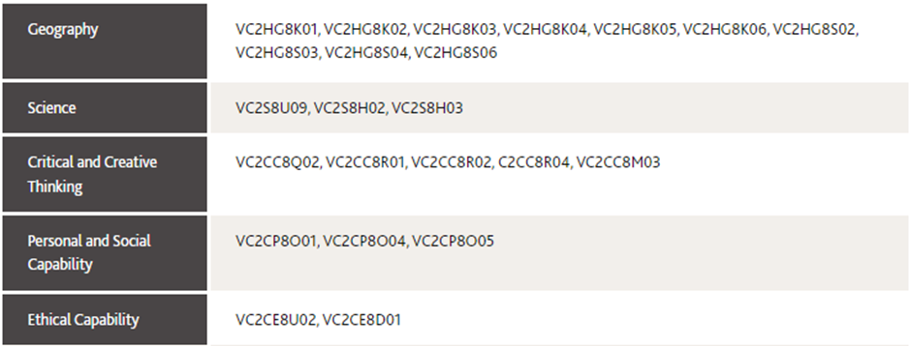
Curriculum links
Notes:
Future predictions
Based on past data and advanced modelling, scientists are able to predict a number of future scenarios for climate, rainfall and evapotranspiration. Full datasets available here: Victorian Water and Climate Initiative. (See appendix for temperature change data.)
Climate change is already having a significant impact on Melbourne’s water supply through a combination of factors:
Reduced and unreliable rainfall: Shifts in rainfall patterns, including reduced rainfall and less frequent overall but more intense rain events – causing storm surges.
Rising mean temperatures: This contributes to higher evaporation rates, which lowers the level of available water in reservoirs.

